Slide 1
CAR: PRICE PREDICTION
Submitted by – Amruta Shah

Slide 2
Information
With the covid 19 impact in the market, we have seen lot of changes in the car market. Now some cars are in demand hence making them costly and some are not in demand hence cheaper. One of our clients works with small traders, who sell used cars. With the change in market due to covid 19 impact, our client is facing problems with their previous car price valuation machine learning models. So, they are looking for new machine learning models from new data. We have to make car price valuation model.
This project contains two phases: -
a) Data Collection Phase
b) Model Building Phase

Slide 3
Problem Statement: -
Business Goal:
Data Collection Phase:-
You have to scrape at least 5000 used cars data. You can scrape more data as well, it’s up to you. more the data better the model In this section You need to scrape the data of used cars from websites (Olx, cardekho, Cars24 etc.) You need web scraping for this. You have to fetch data for different locations. The number of columns for data doesn’t have limit, it’s up to you and your creativity. Generally, these columns are Brand, model, variant, manufacturing year, driven kilometers, fuel, number of owners, location and at last target variable Price of the car. This data is to give you a hint about important variables in used car model. You can make changes to it, you can add or you can remove some columns, it completely depends on the website from which you are fetching the data. Try to include all types of cars in your data for example- SUV, Sedans, Coupe, minivan, Hatchback.

Slide 4
Problem Statement: -
b) Model Building Phase:-
After collecting the data, you need to build a machine learning model. Before model building do all data pre-processing steps. Try different models with different hyper parameters and select the best model. Follow the complete life cycle of data science. Include all the steps like.
1. Data Cleaning
2. Exploratory Data Analysis
3. Data Pre-processing
4. Model Building
5. Model Evaluation
6. Selecting the best mode

Slide 5
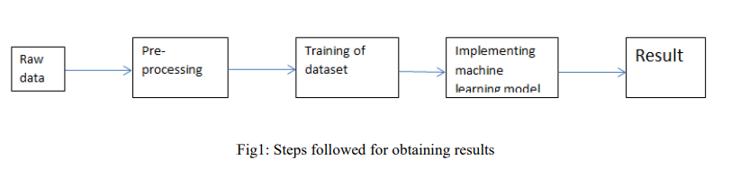
Methodology:-
The steps followed in this work, right from the dataset preparation to obtaining results are represented in Fig.

Slide 6
EDA (Exploratory Data Analysis):-
Import libraries: -
Import pandas as pd # for data manipulation
Import numpy as np # for mathematical calculations
Import seaborn as sns # for data visualization
Import matplotlib.pyplot as plt #for graphical analysis
%matplotlib inline
Import warnings # to ignore any warnings

Slide 7
Technical Requirements:
Data contains 5024 entries each having 7 variables.
• Data contains Null values. You need to treat them using the domain knowledge and your own understanding.
• Extensive EDA has to be performed to gain relationships of important variable and price.
• Data contains numerical as well as categorical variable. You need to handle them accordingly.
• You have to build Machine Learning models, apply regularization and determine the optimal values of Hyper Parameters. If any.
• Two task is their data scrapping by using web scarping and saved it as csv file & then use this file to build the model.

Slide 8
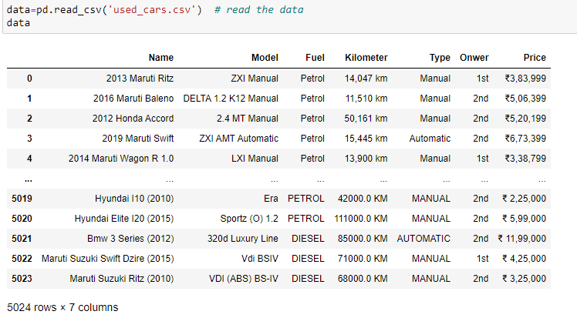
Load Dataset

Slide 9
Observations
There are 7 columns and 5024 rows in the this dataset
There are null values are present in this dataset.
We have categorical data type(object type).
Need to use pre-processing methods to convert categorical data to numerical.
Skewness and Outliers are present.
We can see that in most of the objective columns there in NA with some categorical value. Need to fill that value with one of category.

Slide 10
Data Visualization
We now have a basic idea about the data. We need to extend that with some visualizations. We are going to look at three types of plots:
Univariate plots to better understand each variable.
Bivariate plots to find relationship between two variables,
Multivariate plots to better understand the relationships between variables.

Slide 11
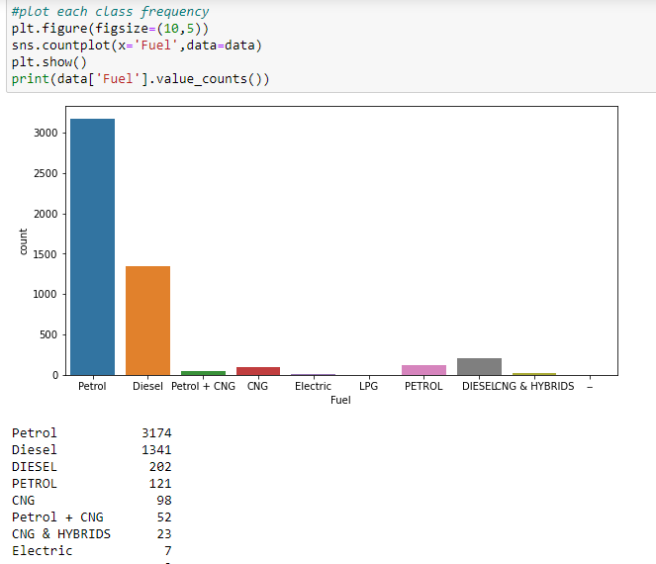
Univariate Plots:-

Slide 12
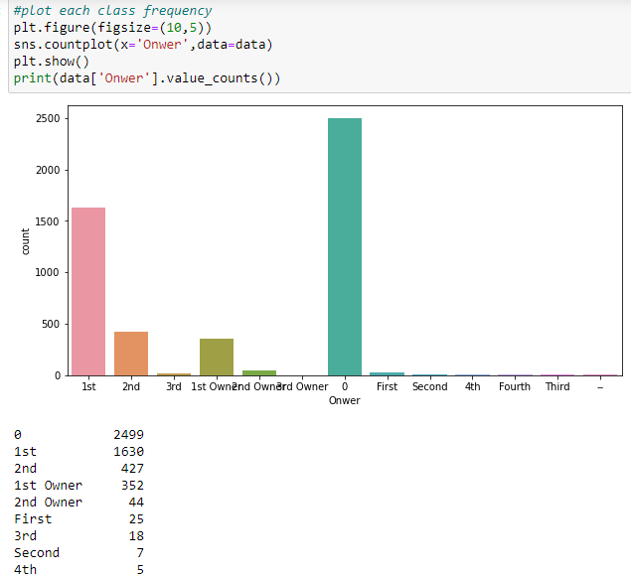

Slide 13
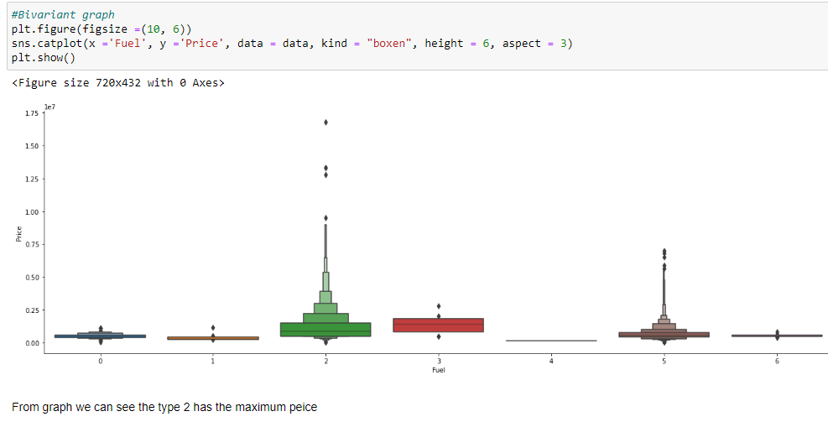
Bivariate Plot

Slide 14
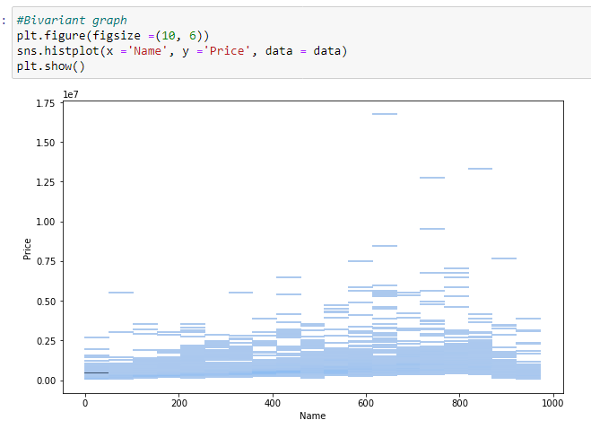

Slide 15
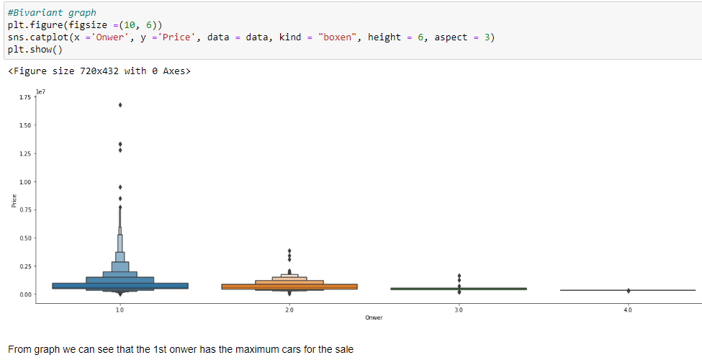

Slide 16
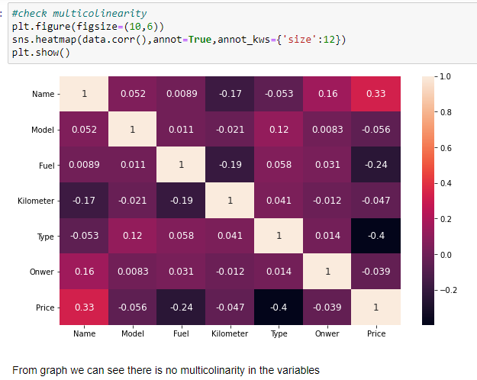
Multivariate Plot

Slide 17
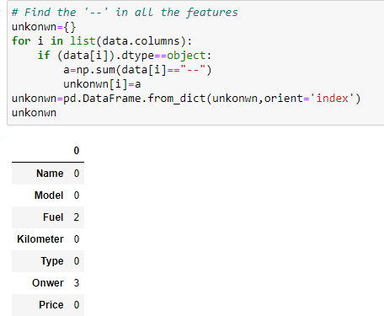
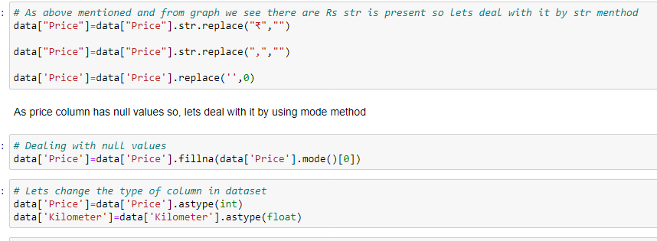
Data Pre-processing:-
In this dataset there are some objectives are mentioned as NA so first lets change to particular value as per mentioned in data description. Refer below fig.

Slide 18
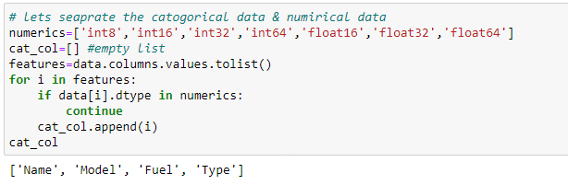
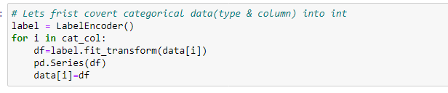
Separating data & Encoding :-

Slide 19
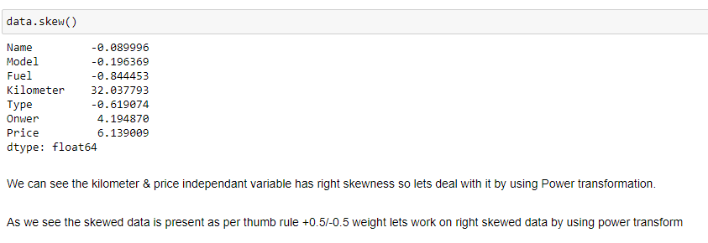
Check Skewness

Slide 20
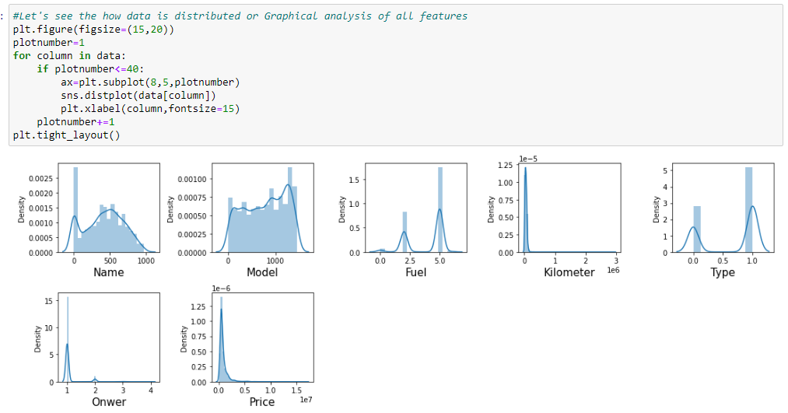
Distribution plot for skewness

Slide 21

Power Transformation to remove skewness

Slide 22
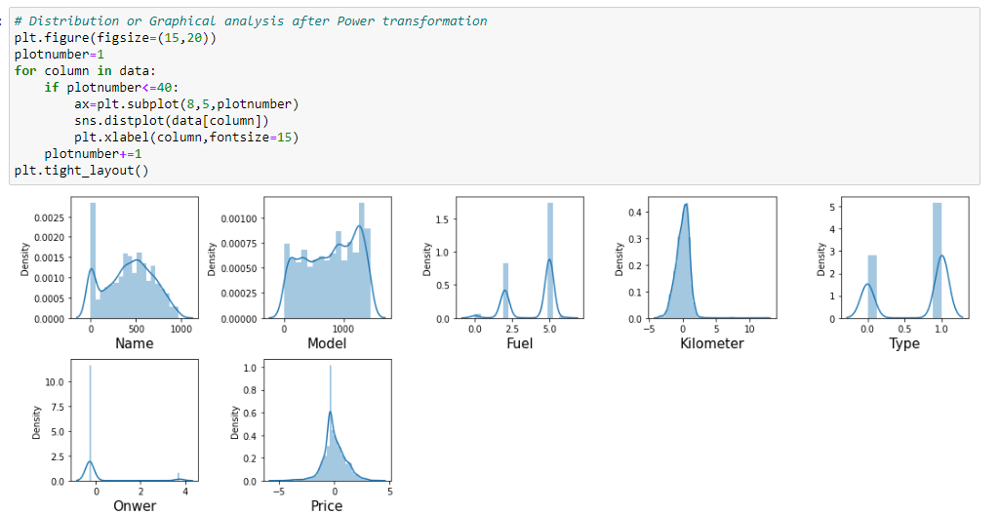
Distribution after removing skewness

Slide 23
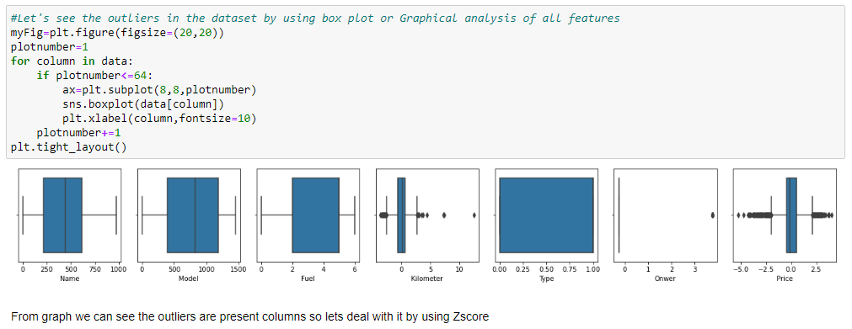
Distribution to see outliers

Slide 24
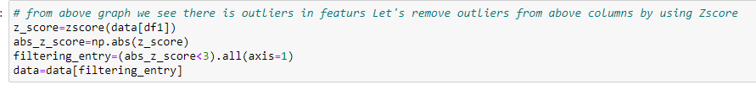
ZScore to remove outliers

Slide 25
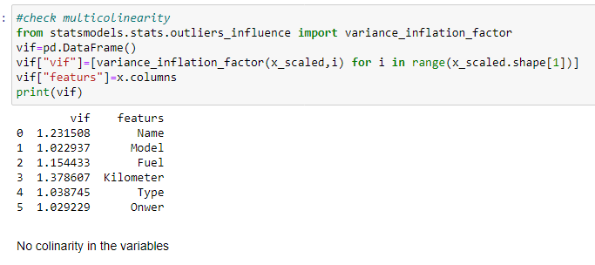
Multicollinearity by VIF

Slide 26
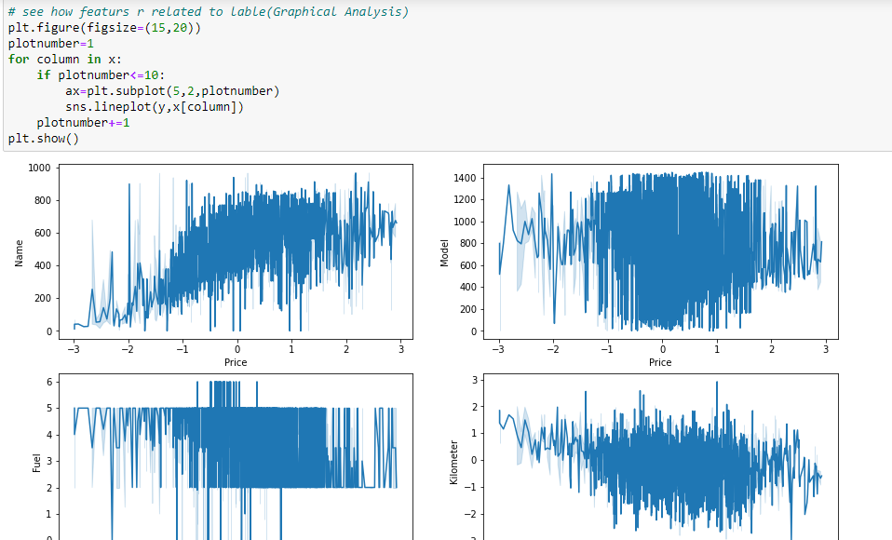

Slide 27
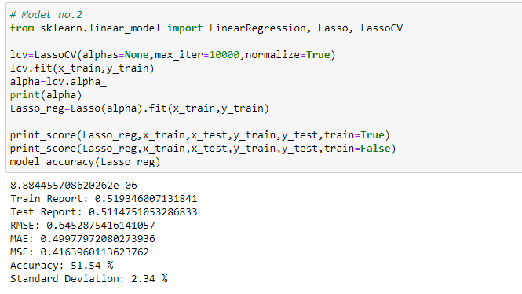
Build the models & select best one

Slide 28
In this project we build the regression model that can predict car price of used car. The challenge behind predicting models is EDA & feature selection. We have gone through how to implement the entire machine learning pipeline, and we have an intuitive understanding of machine learning algorithms. The larger the dataset gets, the more complex each of the mentioned steps gets. Therefore, using this as a base will help while you build your knowledge of machine learning pipelines. This Paper has presented a supervised housing sales price learning model which used machine learning algorithms to predict the price. We used different machine learning algorithm to check the accuracy of price prediction.
Conclusion and Future Scope: -

